Slide 1
Kotlin make Android Development easier and faster
Deni Rohimat
GDK 2019 Bandung, 6 Juli 2019

Slide 2

Hi, I’m Deni Rohimat
I’m passionate about building great products that make people’s lives easier.
I have over 8 years learning Android and make over 50++ apps.
Associate Android Developer
DSC Lead Widyatama University.
Graduated Dicoding MADE & KADE class.
Facilitator of Google Developer Kejar 2018 (Batch 1 & 2), 2019
I grew up in Bandung, there’s I with my friend build a community called ADB (Android Developer Bandung). Join with Us on Telegram https://t.me/androidDevBdg

Slide 3
Skills & expertise
Android Development
Project Management
Team Management
Trainer
Speaker

Slide 4
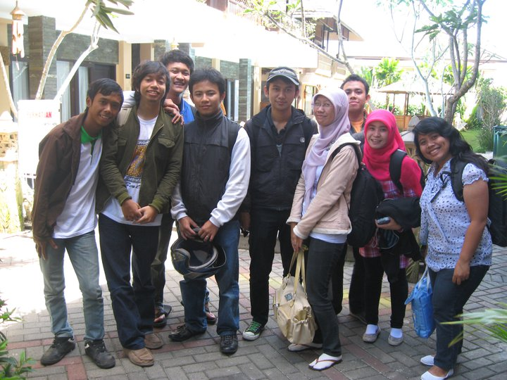
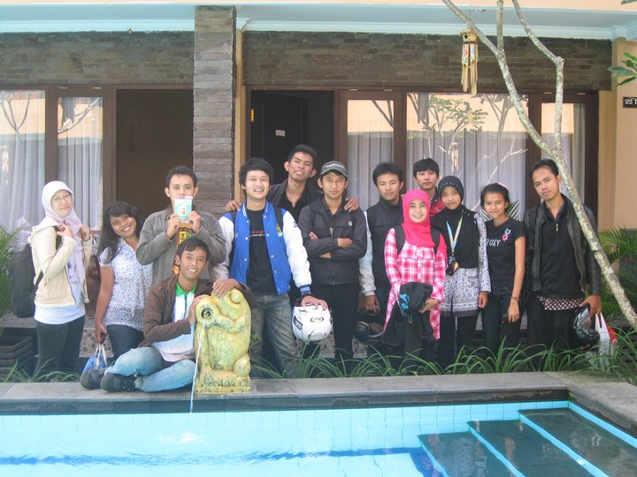
2011 - Android Boot Camp

Slide 5
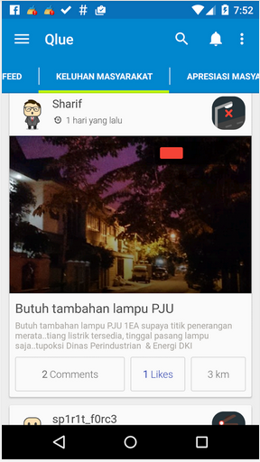
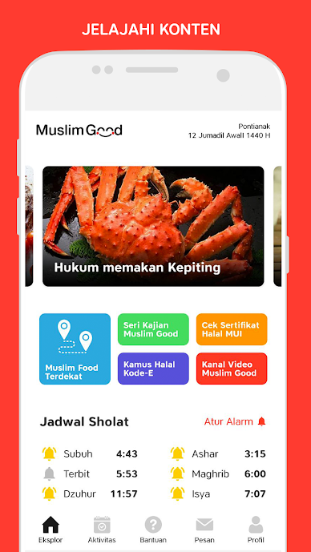
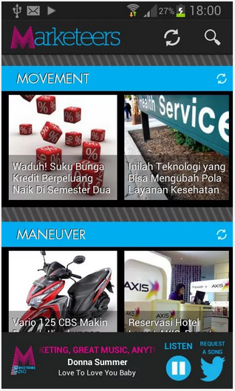
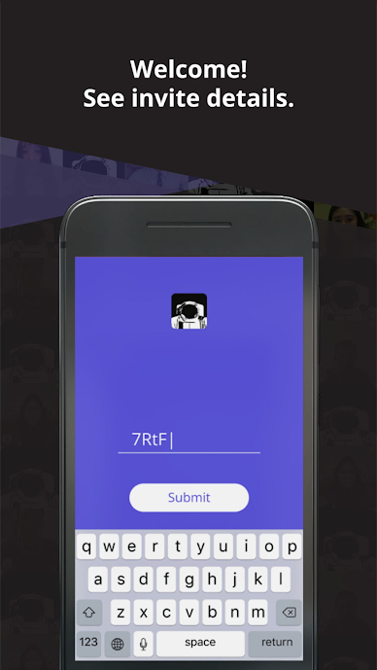
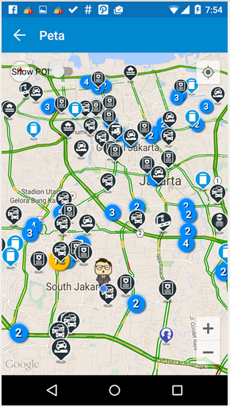
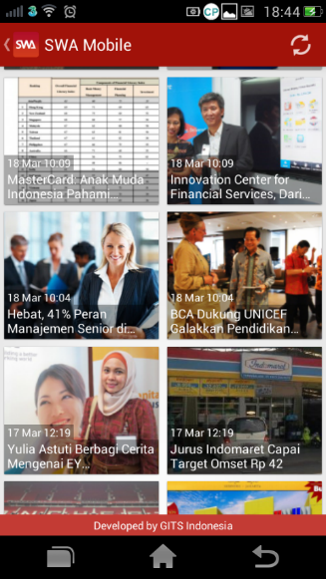
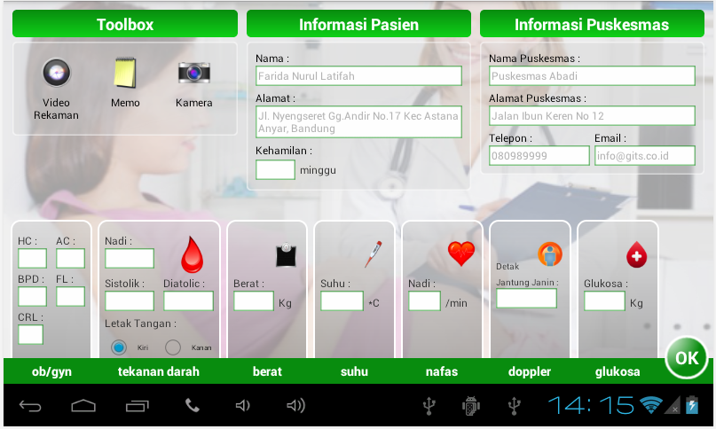
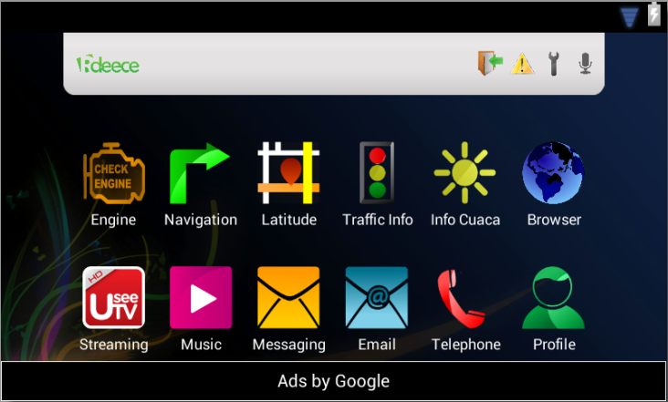
Android App
More info at https://sites.google.com/view/deni-rohimat

Slide 6
Introduction
Why you must change Java to Kotlin ?
As we know, Java has been used for many years and we also know that java is the primary language for Android app development but that doesn’t mean Java is always the best choice because it has some cons like error-prone, old, slower modernization and verbose.
These are making Java a less preferable option for android app development.

Slide 7
“I call it my billion-dollar mistake. It was the invention of the null reference in 1965…This has led to innumerable errors, vulnerabilities, and system crashes, which have probably caused a billion dollars of pain and damage in the last forty years.”
Sir Charles Antony Richard Hoare
Notes:
Sir Charles Antony Richard Hoare FRS FREng (born 11 January 1934), is a British computer scientist. He developed the sorting algorithm quicksort in 1959/1960.

Slide 8
While Java was built years ago when Android wasn’t introduced, somewhere, it lacks a mobile-first approach in the development.
Notes:
Sir Charles Antony Richard Hoare FRS FREng (born 11 January 1934), is a British computer scientist. He developed the sorting algorithm quicksort in 1959/1960.

Slide 9
Here are several pros of Java language:
It’s easy to understand and learn
Easier to execute — run code in a browser or in a virtual machine
Open-source and up-to-date, and feature-rich programming language
Ability to assemble large projects precisely with the help of modern tools
Wide community support that keeps Java up-to-date
Owned by Oracle Corporation who is dedicated to making it stronger
Android depends on Java language
Flexibility for cross-platform app development
Automatic and effective memory management makes it portable to use on a range of devices from large networks to the lowest PCs

Slide 10
What is Kotlin ?
Kotlin is considered as statically typed programming language that runs on JVM(Java Virtual Machine). It is developed by JetBrains and open-source community. The ‘Kotlin’ name came from Kotlin Island located near the Saint Petersburg. It is supported by leading IDEs and compatible for Java 6 or Java 8

Slide 11
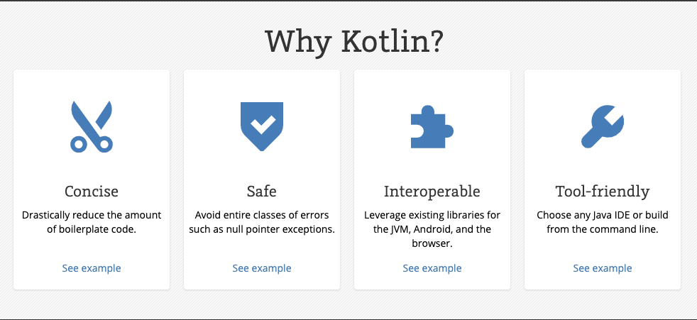

Slide 12
Why should use Kotlin ?
Kotlin is much safer than Java
Interoperability
No semi-colons
No cost to adoption
You’ll develop application faster with less complexity
Quality improvement in the application
Kotlin for Android: The easy learning curve

Slide 13
1. Kotlin is much safer than Java
If we talk about Java, we all know about ‘NullPointerException’. In reality, we also feel extremely disappointed because it’s a noteworthy issue in the design of the language itself.
But if we talk about Kotlin for Android, it reverts into:
Less errors
The compiler can detect those errors like NullPointerException
Understanding of code is much easier
It helps to do work more in less time

Slide 14
2. Interoperability
Kotlin is 100% interoperable with Java, meaning that you can leverage all existing Java libraries, JVM, and frameworks.
You can call Java code from Kotlin and vice-versa seamlessly. Both Kotlin and Java generate the same bytecode, so there's no fear that you're shipping something completely different with Kotlin.
Notes:
That means you can start using Kotlin in your existing project, with all your old Java code, right away. Start by writing some simple and small parts of your app in Kotlin as you start getting familiar with its constructs and syntax (which, by the way, is super-simple).
This mix of Java and Kotlin code is working well in my project. Its interoperability is truly a blessing.

Slide 15
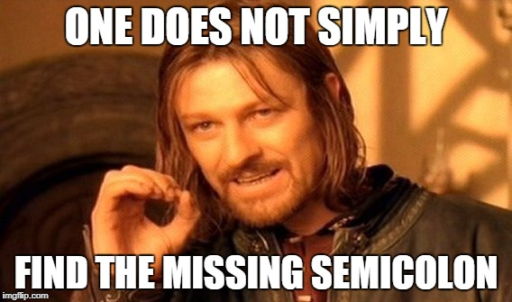
3. No Semi-colons
This may seem like a little thing at first, however, the way that Kotlin code doesn’t expect you to end lines with semi-colons means that you will never need to chase for missing punctuation again! You’re as still ready to utilize them if you wish, yet you’re by and by allowed to pick.

Slide 16
4. No cost to adoption
There is no expense of adopting Kotlin because Kotlin is an open source language. It is totally free and accessible for everybody to utilize. On the off chance that you have old Java projects, nothing to fuss about. Basically, utilize the Java-to-Kotlin converter module and all Java code will be changed over into Kotlin code. Your record size and code difficulty will also decrease.

Slide 17
5. You’ll develop application faster with less complexity
Kotlin requires fewer lines of code from other programming languages. It is a naturally compact language, so it can solve numerous basic improvement issues with only a couple of lines of code.

Slide 18
6. Quality improvement in the application
Kotlin enhances the quality of your applications through “security” features that have been intended to lessen the number of bugs and framework disappointments. For instance, it has a solid sort framework dependent on null-safety. This means, variables can’t be invalid or null, so you can get more errors at compile-time before transportation to clients. This is extremely helpful.

Slide 19
7. Kotlin for Android: The easy learning curve
Kotlin is designed to have a smooth learning to absorb information for Java developers. Java designers should take note of that most Kotlin syntax looks well-known. For example, the code used to create a substitution class in Kotlin is to a great degree like Java.
Kotlin is designed to be instinctive and simple to filter, whether you discover a code that is drastically unexpected. You should still have the capacity to get the essence of what this code is doing.

Slide 20
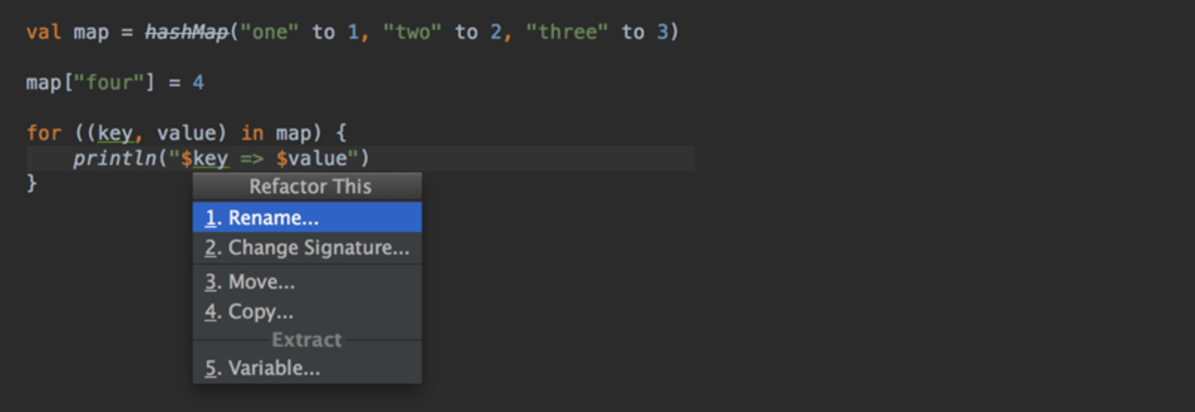
Another Reason
Great IDE and tooling support

Slide 21
Java vs Kotlin: Several Things From Developers’ Perspective

Slide 22
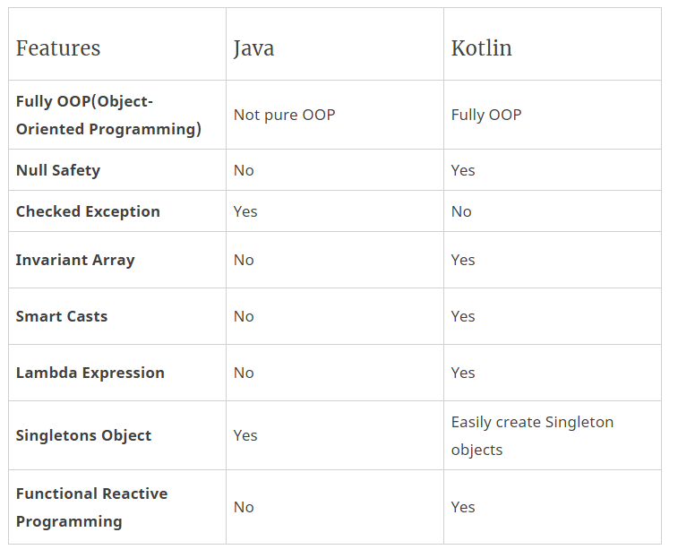

Slide 23
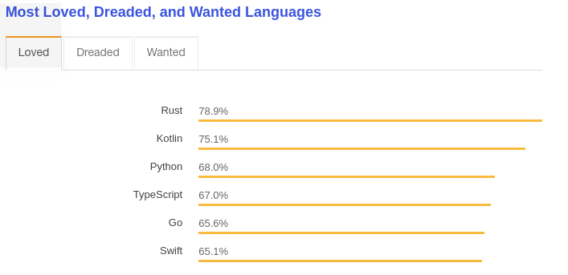
Most Loved Language in 2018
1
Kotlin was the 2nd most loved Programming language in 2018 as per the Stack Overflow Annual developer Survey. Source: StackOverflow

Slide 24
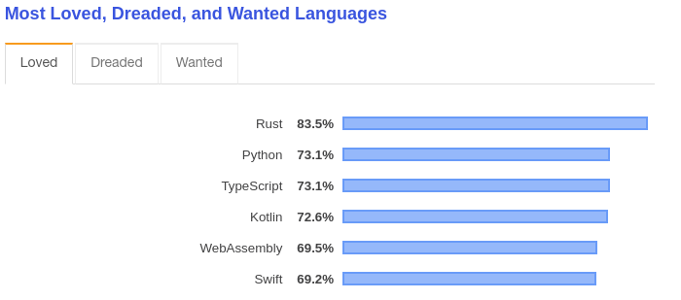
Most Loved Language in 2019
1
Kotlin moved down to 2 places as the 4th most loved Programming language of 2019 as per Stack Overflow’s annual Developer survey. Source: StackOverflow

Slide 25
At the Google I/O 2019 announced that Android development will go Kotlin-first, and encouraged developers to leverage the Kotlin language for mobile app development.

Slide 26
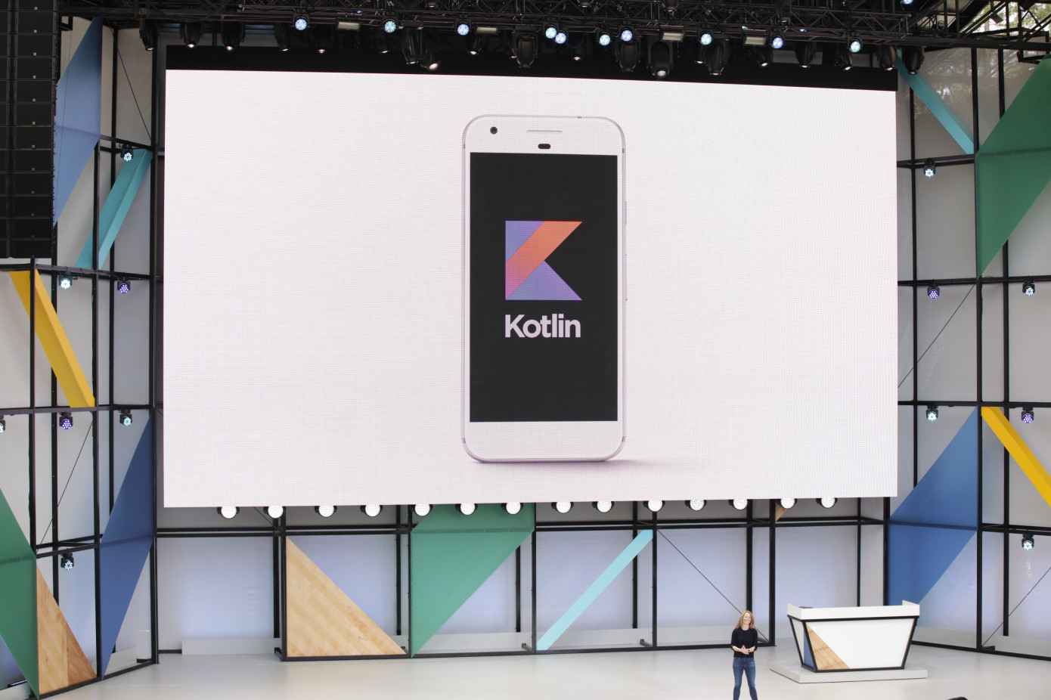

Slide 27
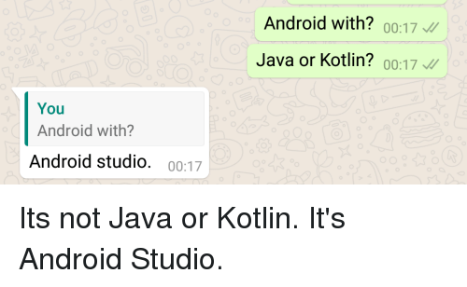
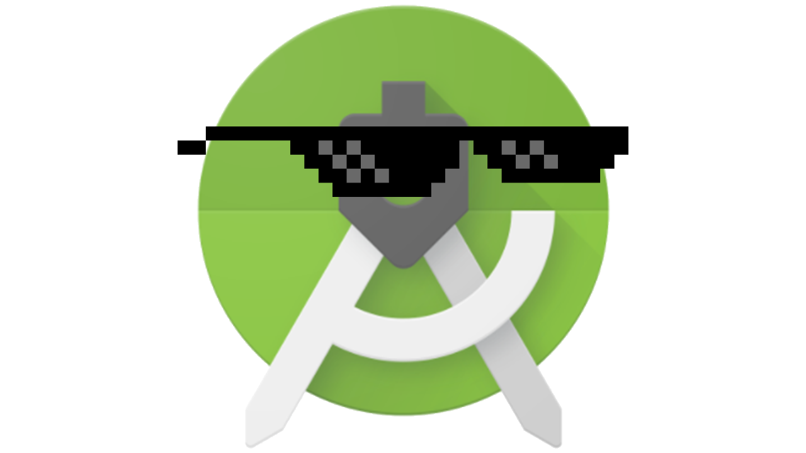
Java or Kotlin ?

Slide 28
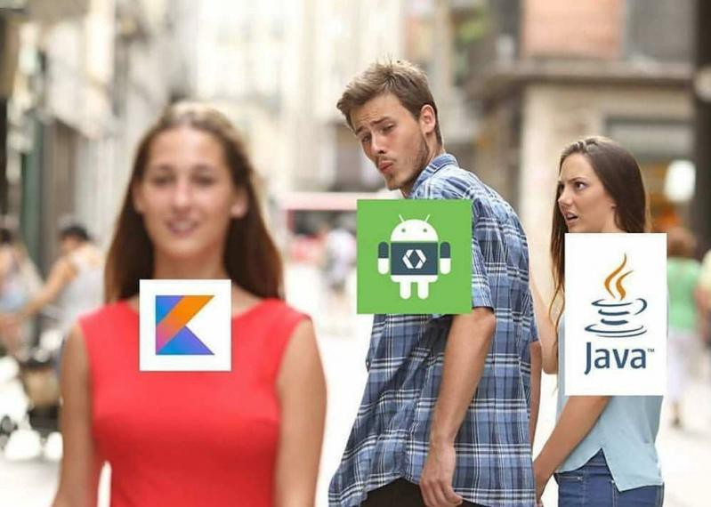

Slide 29
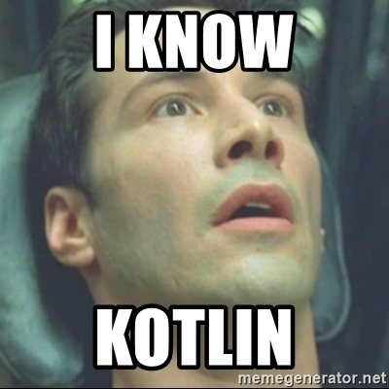
Easier way to become Kotlin Developer
Select your old Java File
“Convert Java File to Kotlin”

Slide 30
Easier way to become Kotlin Developer
Select your old Java File
“Convert Java File to Kotlin”

Slide 31
Some sample code Java vs Kotlin

Slide 32
“Hello World” program in Java:
class HelloWorldApp{
public static void main(String[] args) {
System.out.println("Hello World!");
}
}

Slide 33
“Hello World” program in Kotlin:
package hello
fun main() {
println("Hello World")
}

Slide 34
OnClick on Java:
view.setOnClickListener(new View.OnClickListener() {
@Override
public void onClick(View v) {
// Do whatever you want to
}});

Slide 35
OnClick on Kotlin:
view.setOnClickListener { // Do whatever you want to }

Slide 36
Cons Of Kotlin Programming Language:
Limited learning resources as it is a small and new community
It may become a challenge to switch from Java to Kotlin for your team
Finding Kotlin developers seems difficult than Java developers
Sometimes compilation is slower compared to Java

Slide 37
What Should You Choose To Develop Your Next App?
Certainly, Kotlin can give a competitive edge. It saves your time and efforts in development achieving faster time-to-market of your app.

Slide 38
Choose Kotlin When
You have Kotlin developers who have experience in developing apps in Kotlin
When you want to give a modern, fresh look to your application
When you want to accomplish faster time-to-market of app
When your team has proper knowledge of frameworks and tools

Slide 39
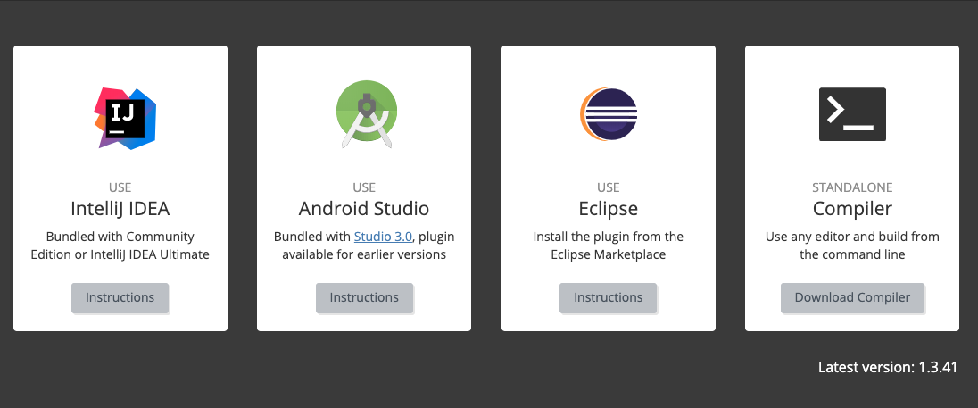

Slide 40
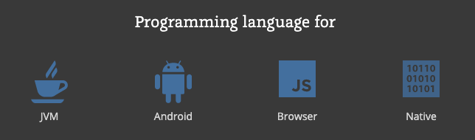

Slide 41
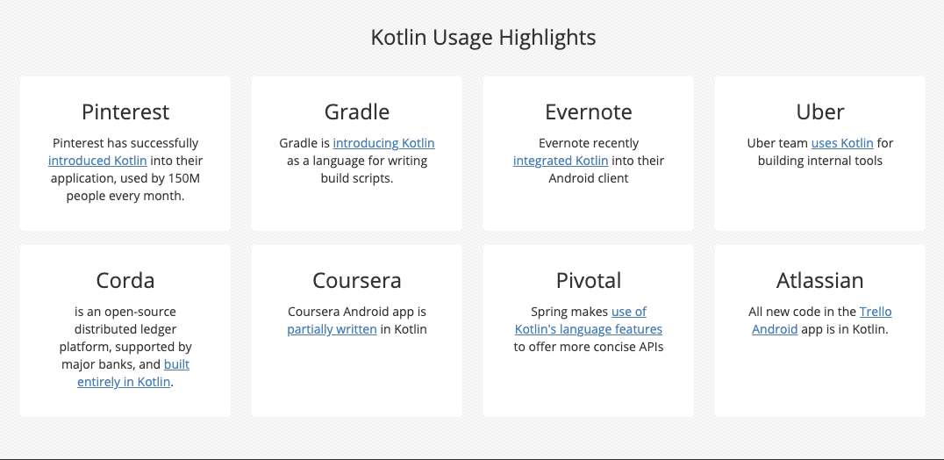

Slide 42
Questions?

Slide 43
References
https://kotlinlang.org/
http://binaryinformatics.com/why-should-you-try-kotlin-for-android-development/
https://hackernoon.com/java-vs-kotlin-its-time-to-expand-android-development-f08e3d6a72b6
https://techcrunch.com/2019/05/07/kotlin-is-now-googles-preferred-language-for-android-app-development/
https://blog.jetbrains.com/kotlin/2017/05/kotlin-on-android-now-official/

